Slide 1

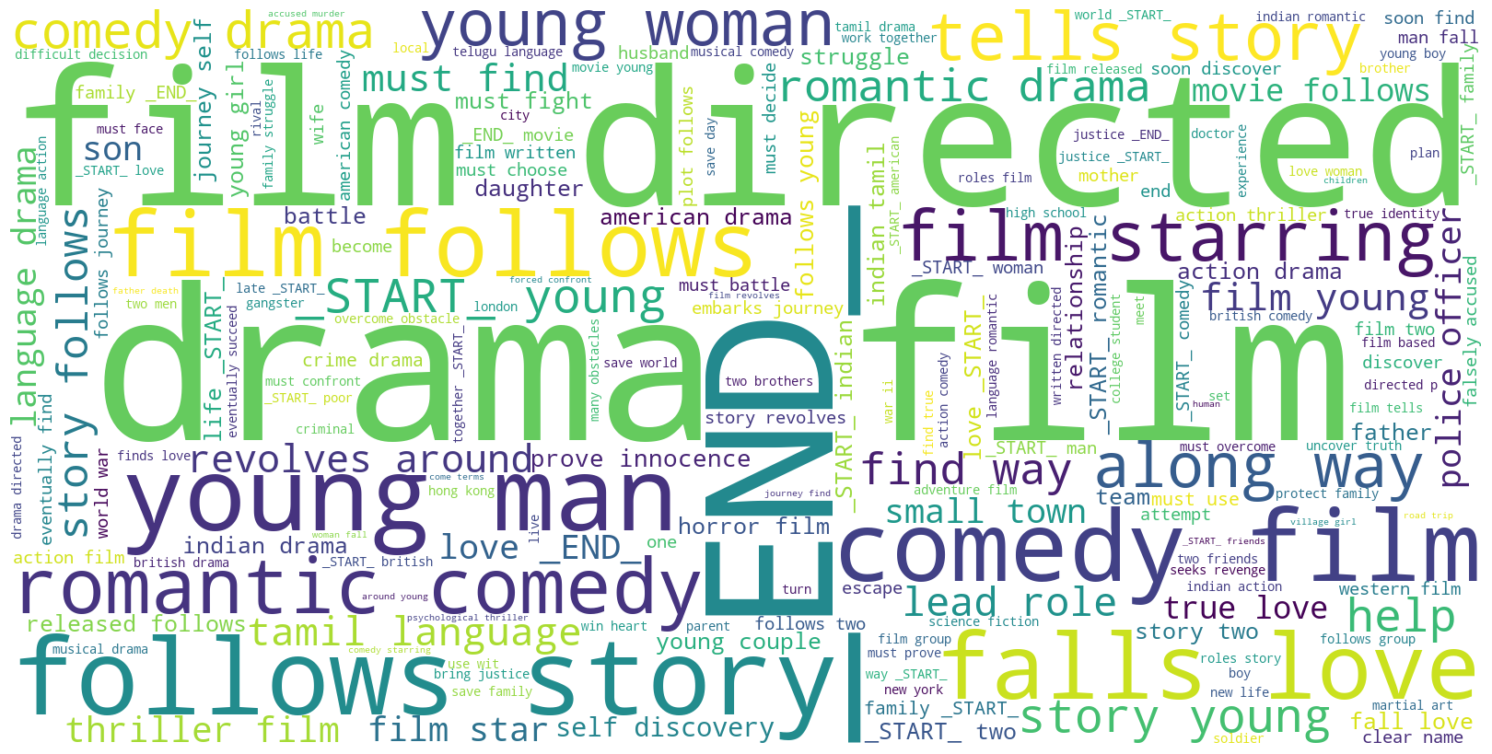
Text Summarization Using Encoder Decoder Generative Adversarial Networks
INDIAN INSTITUTE OF TECHNOLOGY JODHPUR
Presented by: Tathagata Mookherjee
(M21AI619)
Supervisor: Dr. Gaurav Harit

Slide 2
Introduction and Motivation
Text summarization has a long history, with early research dating back to the 1950s.
LSTM based Encoder Decoders (EDs) were introduced by Ilya Sutskever in 2014.
Generative adversarial networks (GANs) were introduced by Ian Goodfellow in 2014.
It was proposed that GANs can also be used to perform text summarization by L. Liu in 2018.
GANs and EDs have been combined to perform efficient pattern recognition on images by F. Carrara 2021.
EDs have been demonstrated to be effective in text summarization.
Industry standard technologies: Amazon Comprehend, Azure Cognitive Service for Language, fastText , BART.
There is an opportunity to combine a GAN with an ED to perform efficient text summarization.

Slide 3
Looking at the data
Data collection
For this project the requirement was to collect a large dataset of long and complex movie plots, along with shorter and summaries of the same. This data was retrieved using a ChatGPT 3.5 API.
Data preparation
Lowercasing all the words
Contraction removal
Punctuation and double space removal
Stop words removal
Splitting the data into training and test sets
Sentence tokenization using NLTK

Slide 4
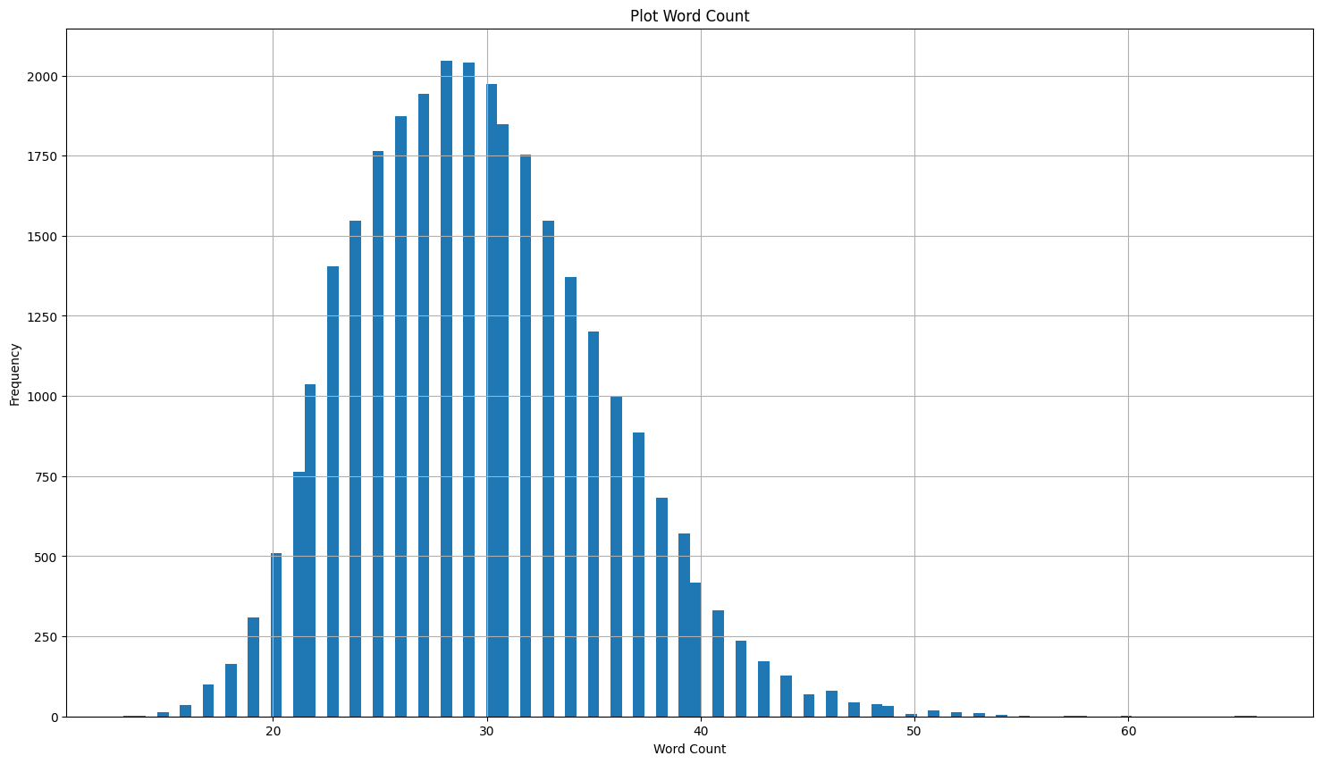
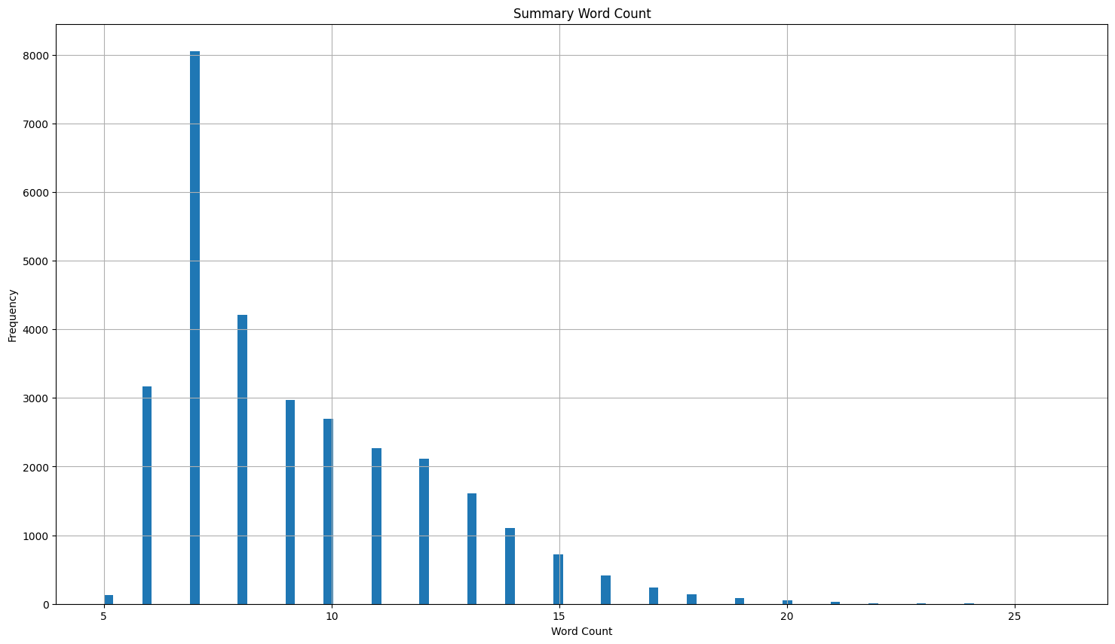
Data distribution
Modal plot word length = 28
Vocabulary size = 29315
Modal summary word length = 7
Vocabulary size = 12877

Slide 5
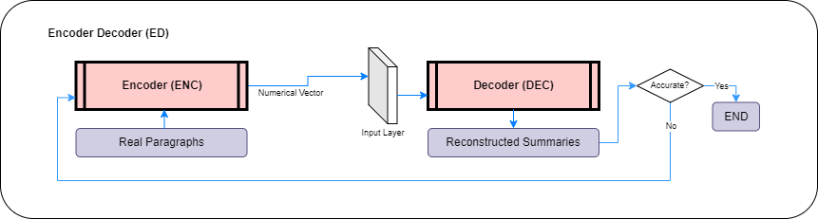
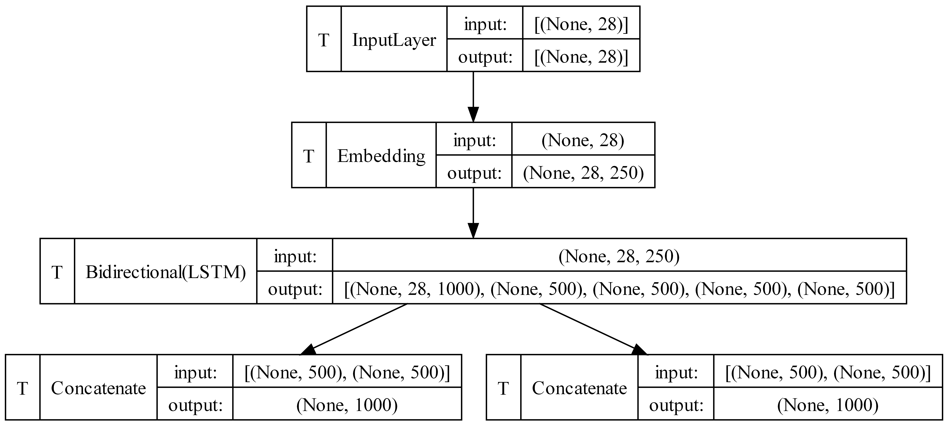
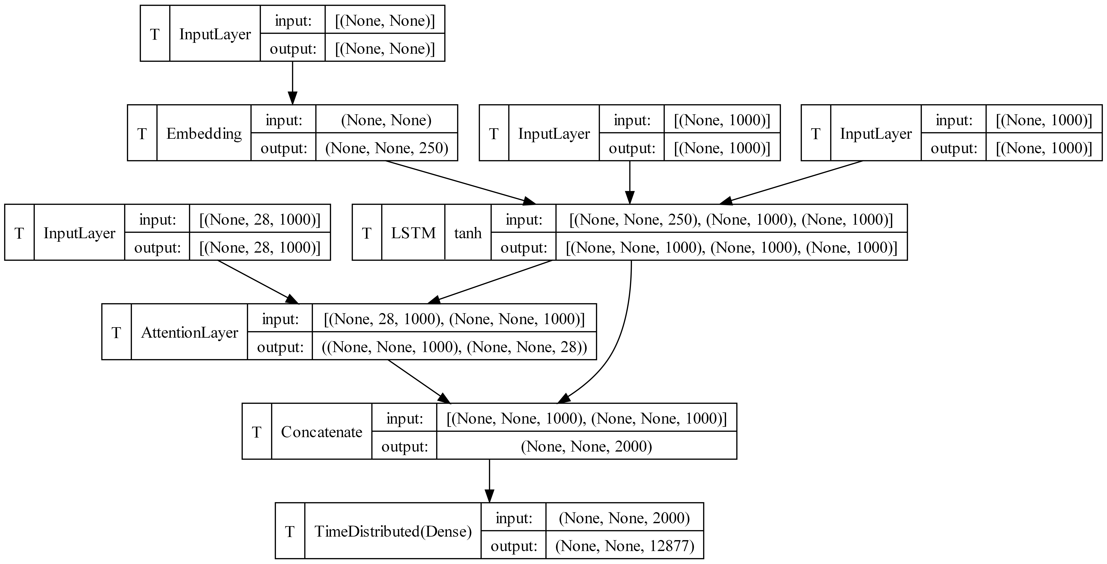
ED architecting and training
We aim to train the encoder (ENC) to create a compact context vector based on a given paragraph, while training the decoder (DEC) to reconstruct the summary from this context vector.
Encoder
Plot vocabulary size = 29315 (from dataset)
Dropout = [0.3, 0.5, 0.7]
Modal plot word length = 28 (from dataset)
Decoder
Summary vocabulary size = 12877 (from dataset)
Modal summary word length = 7 (from dataset)
Bidirectional LSTM layers(s) = [1, 2, 3]
Embedding dimension = [250, 500, 750]
Latent dimension = Embedding dimension X 2
Learning rate = [0.01, 0.001, 0.0001]
Loss = Sparse Categorical Cross-entropy
Optimizer = Adam
Activation = Tanh
Batch size = [15, 30, 45, 60]
Epochs = [Batch size, Batch size X 2]
ENC
DEC

Slide 6
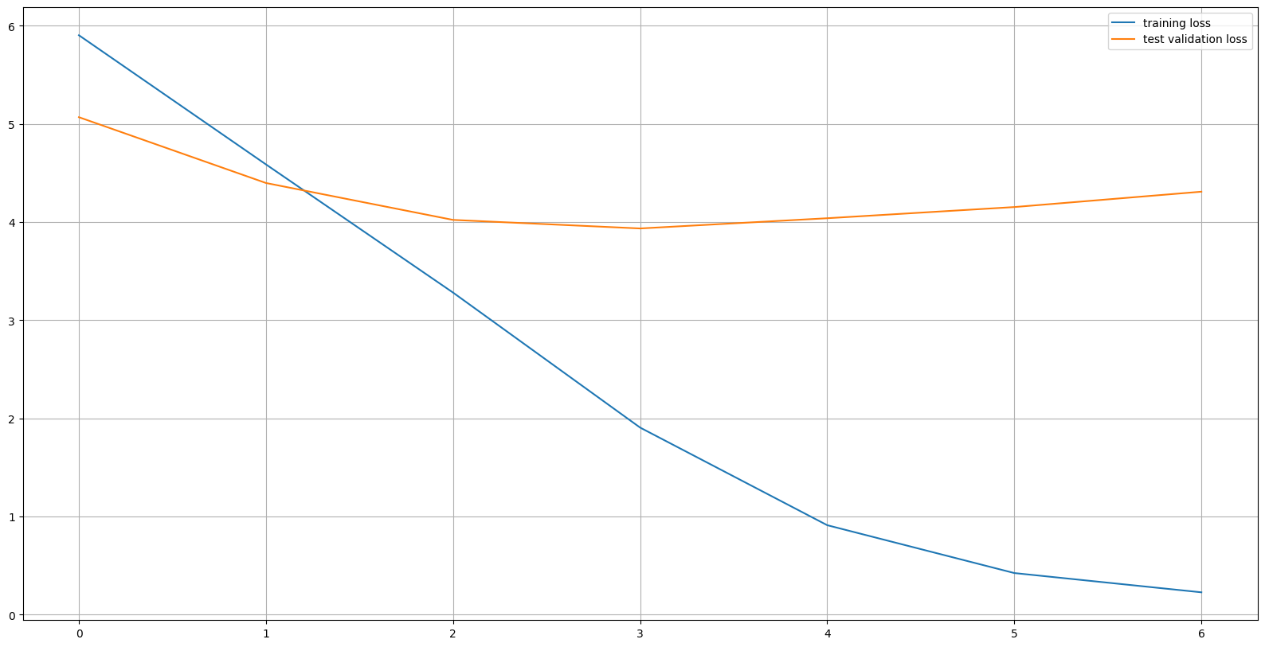
ED training & validation
Training and validation
Performance Scores
Average BLEU score: 0.12783402849202055
Average WER score: 0.8121043379921574
Average METEOR score: 0.21730916614721613
Average ROUGE-1 precision: 0.30612285036443937
Average ROUGE-1 recall: 0.2742617089613519
Average ROUGE-1 f-measure: 0.28748736481889914
Average ROUGE-L precision: 0.2953018401740259
Average ROUGE-L recall: 0.2652395176457664
Average ROUGE-L f-measure: 0.27770761606359745
BLEU: Bilingual Evaluation Understudy
METEOR: Metric for Evaluation of Translation with Explicit Ordering
WER: Word Error Rate
ROUGE-1: Recall-Oriented Understudy for Gisting Evaluation 1-Gram
ROUGE-L: Longest Common Subsequence Recall-Oriented Understudy for Gisting Evaluation

Slide 7
ED output sample
Input Data
Title | Summary | Plot | Cleaned_Plot | Cleaned_Summary
better times | Silent comedy drama: woman chooses happiness. | Better Times is a 1919 American silent comedy drama film directed by Marshall Neilan. It follows a woman who is forced to choose between her faithless husband and her devoted suitor, and ultimately decides to pursue her own happiness. | better times 1919 american silent comedy drama film directed marshall neilan follows woman forced choose faithless husband devoted suitor ultimately decides pursue happiness | _START_ silent comedy drama woman chooses happiness _END_
dungeonmaster the | Fantasy world, battle powerful force, aided by wizard, guided by Dungeonmaster, return to own world. | Dungeonmaster The is a 1985 fantasy film directed by Rosemarie Turko. It follows a group of people who are transported to a fantasy world where they must battle a powerful force in order to return to their own world. The group is aided by a powerful wizard and the Dungeonmaster, an enigmatic figure who guides them in their quest. | dungeonmaster 1985 fantasy film directed rosemarie turko follows group people transported fantasy world must battle powerful force order return world group aided powerful wizard dungeonmaster enigmatic figure guides quest | _START_ fantasy world battle powerful force aided wizard guided dungeonmaster return world _END_
log kya kahenge | Woman fights for true love. | Log Kya Kahenge is a 1983 Indian Bollywood movie that follows the story of a young woman who is estranged from her family because of her love for a lower class man. Despite facing opposition from her family and society, she fights to protect their relationship and prove her love is true. | log kya kahenge 1983 indian bollywood movie follows story young woman estranged family love lower class man despite facing opposition family society fights protect relationship prove love true | _START_ woman fights true love _END_
the racket | Crime captain takes on mobster. | The Racket is a 1951 film noir crime drama directed by John Cromwell. It follows Tom McQuigg, a police captain determined to take down a powerful crime boss. McQuigg sets up a plan to arrest the boss, but it backfires and leads to a series of events that will test McQuigg's courage and integrity. | racket 1951 film noir crime drama directed john cromwell follows tom mcquigg police captain determined take powerful crime boss mcquigg sets plan arrest boss backfires leads series events test mcquigg courage integrity | _START_ crime captain takes mobster _END_
first blood | Rambo fights for survival against sheriff. | The movie "First Blood" released in 1982 follows John Rambo, a Vietnam veteran, who is forced to face the harsh reality of his past when a small town sheriff tries to arrest him. He must fight for his survival against the sheriff and the forces of the National Guard. | movie first blood released 1982 follows john rambo vietnam veteran forced face harsh reality past small town sheriff tries arrest must fight survival sheriff forces national guard | _START_ rambo fights survival sheriff _END_
Output Data
Plot | Original_summary | Predicted_summary
better times 1919 american silent comedy drama film directed marshall neilan follows woman forced choose faithless husband devoted suitor ultimately decides pursue happiness | silent comedy drama woman chooses happiness | woman chooses happiness happiness
1985 fantasy film directed rosemarie turko follows group people transported fantasy world must battle powerful force order return world group aided powerful wizard dungeonmaster enigmatic figure guides quest | aided wizard guided dungeonmaster return world | wizard rider dungeonmaster evil governor
log kya kahenge 1983 indian bollywood movie follows story young woman estranged family love lower class man despite facing opposition family society fights protect relationship prove love true | woman fights true love | woman fights true love
crime drama directed john cromwell follows tom mcquigg police captain determined take powerful crime boss mcquigg sets plan arrest boss backfires leads series events test mcquigg courage integrity | crime captain takes mobster | crime corruption takes control
movie first blood released 1982 follows john rambo vietnam veteran forced face harsh reality past small town sheriff tries arrest must fight survival sheriff forces national guard | rambo fights survival sheriff | rambo fights mob sheriff

Slide 8
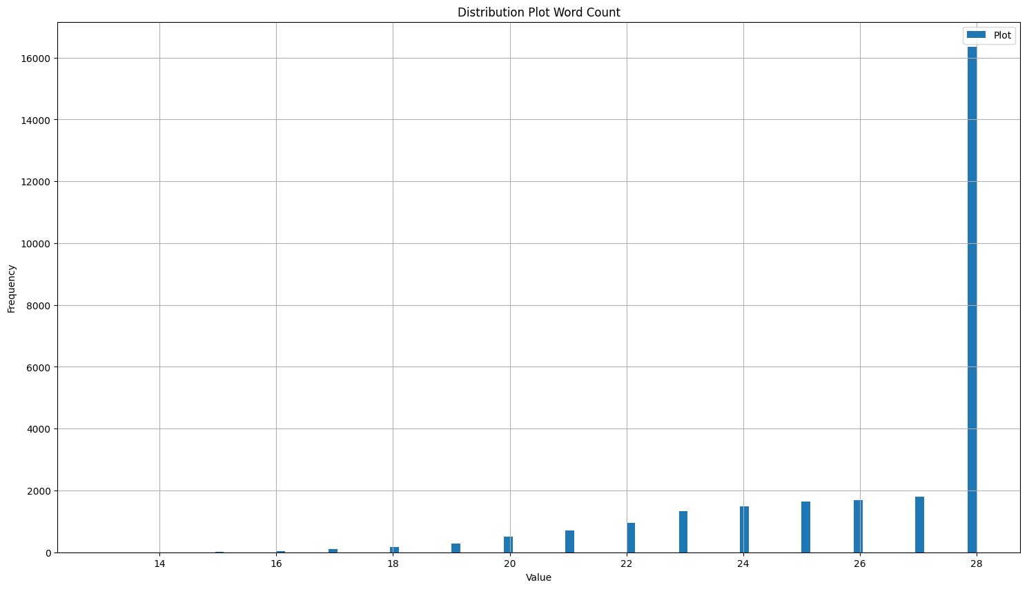
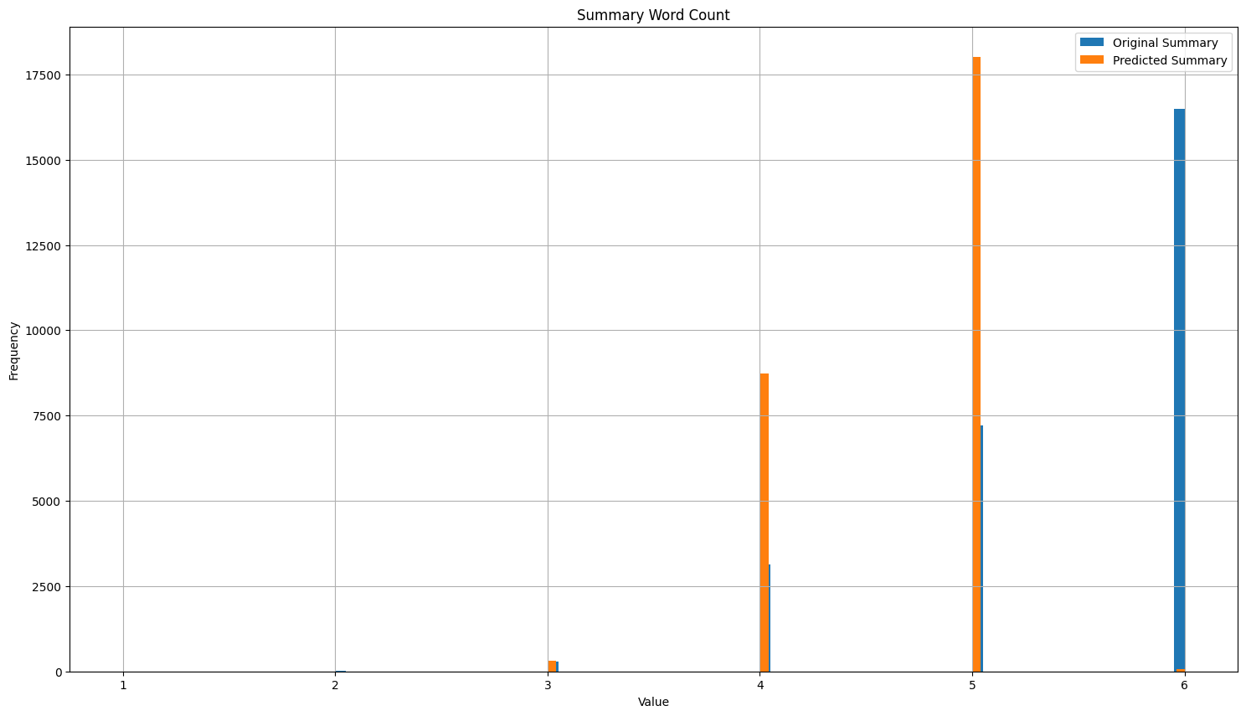
Data distribution of ED output
Modal plot word length = 28
Vocabulary size = 22333
Modal Original summary word length = 6
Modal Predicted summary word length = 5

Slide 9
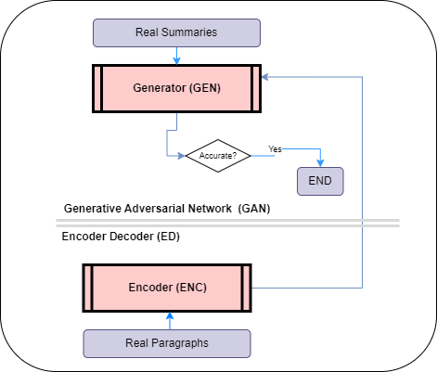
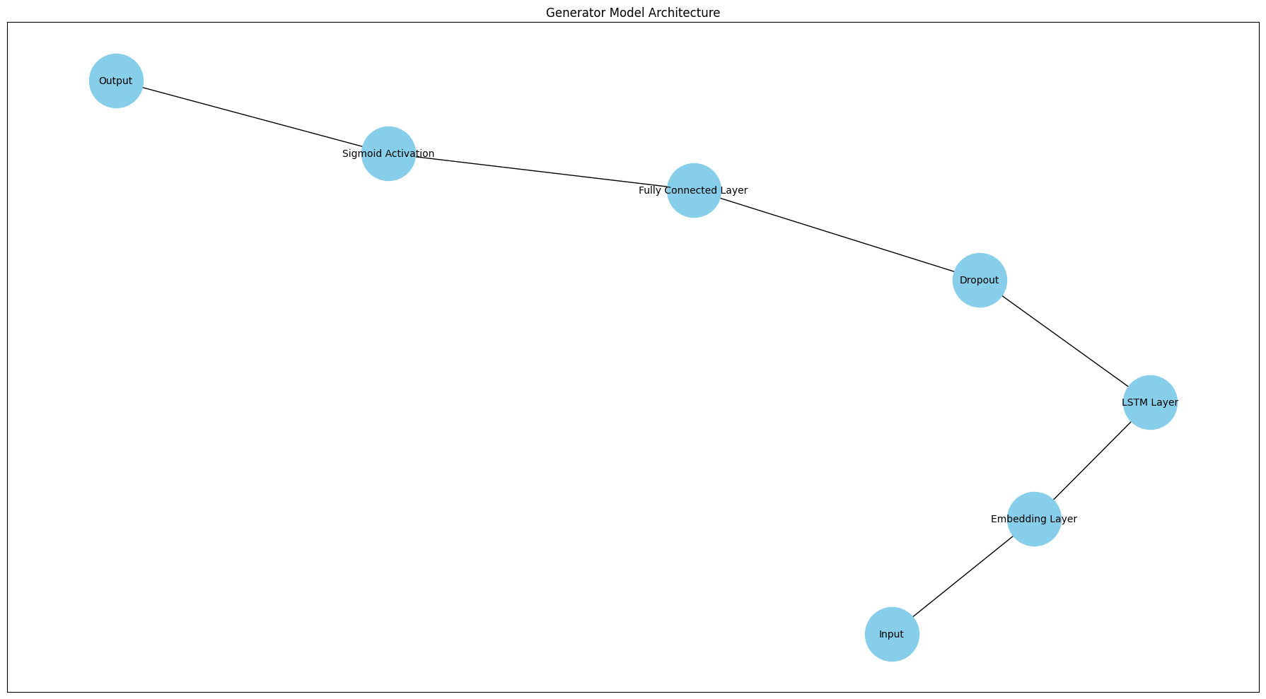
GEN pretraining with ED output
We aim to pretrain the generator (GEN) using the output of the encoder (ENC) such that it produces a compact representation of a given paragraph. Subsequently, this representation will be used by the decoder (DEC) to generate the summary.
Vocabulary size = 22333 (from dataset)
Embedding dimension = [250, 500, 750]
Latent dimension = [Embedding dimension, Embedding dimension X 2]
LSTM layers(s) = [1, 2, 3]
Batch size = [15, 30, 45, 60]
Epochs = [Batch size, Batch size X 2]
Predicted summary word length = 5 (from dataset)
Dropout = [0.3, 0.5, 0.7]
Learning rate = [0.01, 0.001, 0.0001]
Loss = Cross Entropy
Text length = 6 (from dataset)
Optimizer = Adam
Activation = Sigmoid
Early Stopping = 2

Slide 10
GEN Pretraining Losses

Slide 11
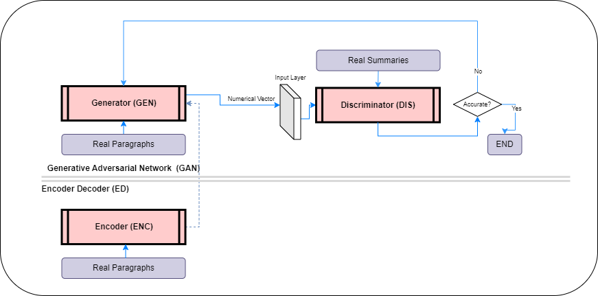
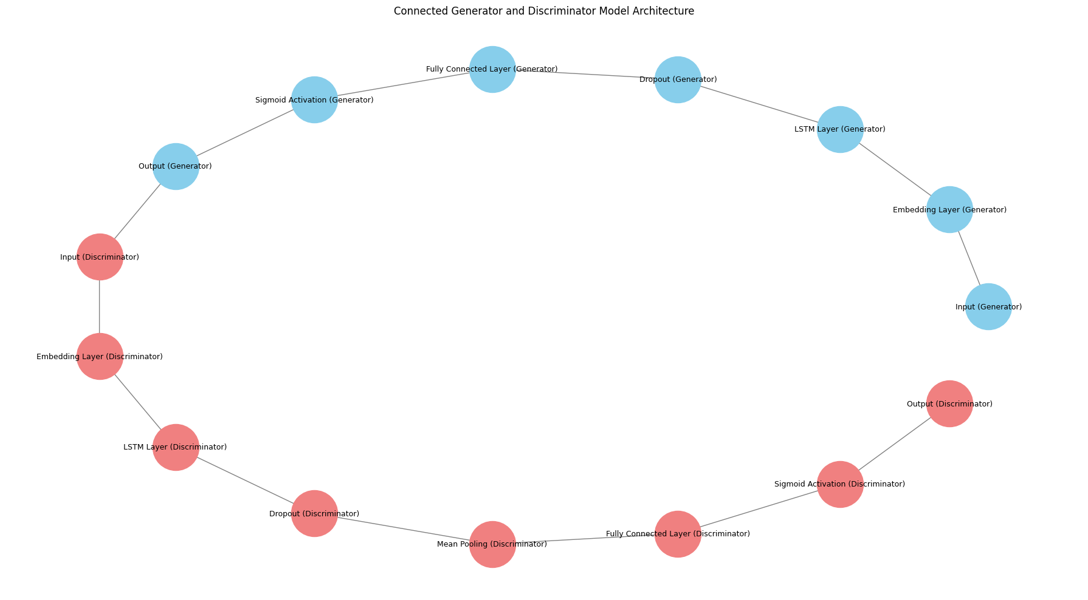
GAN training with pretrained GEN
We aim to utilize the pretrained generator (GEN) within a GAN framework, where the GEN, leveraging the compact representation learned from the encoder's output, collaboratively trains with a discriminator (DIS) to generate summaries.
Vocabulary size = 22333 (from dataset)
Embedding dimension = [250, 500, 750]
Latent dimension = [Embedding dimension, Embedding dimension X 2]
LSTM layers(s) = [1, 2, 3]
Batch size = [15, 30, 45, 60]
Epochs = [Batch size, Batch size X 2]
Predicted summary word length = 5 (from dataset)
Dropout = [0.3, 0.5, 0.7]
Learning rate = [0.01, 0.001, 0.0001]
Loss = Cross Entropy
Optimizer = Adam
Activation = Sigmoid
Early Stopping = 2

Slide 12
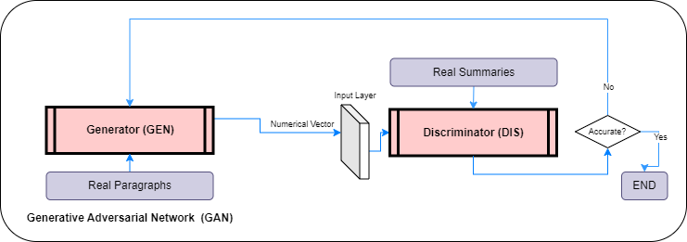
GAN training with untrained GEN
We aim to compare the performance of the pretrained generator (GEN) with an untrained GEN, within a GAN framework, when trained with a discriminator (DIS) to generate summaries.
Vocabulary size = 22333 (from dataset)
Embedding dimension = [250, 500, 750]
Latent dimension = [Embedding dimension, Embedding dimension X 2]
LSTM layers(s) = [1, 2, 3]
Batch size = [15, 30, 45, 60]
Epochs = [Batch size, Batch size X 2]
Predicted summary word length = 5 (from dataset)
Dropout = [0.3, 0.5, 0.7]
Learning rate = [0.01, 0.001, 0.0001]
Loss = Cross Entropy
Optimizer = Adam
Activation = Sigmoid
Early Stopping = 2

Slide 13
GAN Training Losses
Pretrained GEN's values are consistently lower than those of the untrained generator.
The values for the pretrained GEN is generally going downward, which might reach convergence [6]
The untrained GEN’s losses are escalating over time and hence may not reach convergence [5].

Slide 14
GAN Validation Losses
The pretrained DIS, exhibits incrementing values. This upward trajectory might signify the escalating challenge it faces in differentiating genuine samples from those generated artificially.
The untrained DIS's metrics depict a descending trend as testing continues. This points to ease of understanding the differences between real and generated summaries [6].

Slide 15
GAN performance

Slide 16
GAN performance continued…

Slide 17
GAN output
ED Output
Plot | Original_summary | Predicted_summary
better times 1919 american silent comedy drama film directed marshall neilan follows woman forced choose faithless husband devoted suitor ultimately decides pursue happiness | silent comedy drama woman chooses happiness | woman chooses happiness happiness
1985 fantasy film directed rosemarie turko follows group people transported fantasy world must battle powerful force order return world group aided powerful wizard dungeonmaster enigmatic figure guides quest | aided wizard guided dungeonmaster return world | wizard rider dungeonmaster evil governor
log kya kahenge 1983 indian bollywood movie follows story young woman estranged family love lower class man despite facing opposition family society fights protect relationship prove love true | woman fights true love | woman fights true love
crime drama directed john cromwell follows tom mcquigg police captain determined take powerful crime boss mcquigg sets plan arrest boss backfires leads series events test mcquigg courage integrity | crime captain takes mobster | crime corruption takes control
movie first blood released 1982 follows john rambo vietnam veteran forced face harsh reality past small town sheriff tries arrest must fight survival sheriff forces national guard | rambo fights survival sheriff | rambo fights mob sheriff
GAN Output
plot | generated_original_summary
better times 1919 american silent comedy drama film directed marshall neilan follows woman forced choose faithless husband devoted suitor ultimately decides pursue happiness | woman brenda leonard saif chick happiness
1985 fantasy film directed rosemarie turko follows group people transported fantasy world must battle powerful force order return world group aided powerful wizard dungeonmaster enigmatic figure guides quest | nobility wizard evil sturgeon vsevolod ryder officials
log kya kahenge 1983 indian bollywood movie follows story young woman estranged family love lower class man despite facing opposition family society fights protect relationship prove love true | trance woman love ibbetson beth ramakrishnan
crime drama directed john cromwell follows tom mcquigg police captain determined take powerful crime boss mcquigg sets plan arrest boss backfires leads series events test mcquigg courage integrity | ones crime tuesdays forensic control belonging
movie first blood released 1982 follows john rambo vietnam veteran forced face harsh reality past small town sheriff tries arrest must fight survival sheriff forces national guard | rambo drilling mob chakoram tower fitri

Slide 18
Conclusion and further discussions
Traditional summarization techniques focus on extracting or rephrasing existing content. The adversarial nature of GANs, when applied to this task, can push the boundaries of what's possible, leading to the generation of summaries that are not just extracts but possibly innovative reinterpretations of the content.
These GANs might have utility in “idea generation” applications.
There are multiple challenges when using EDGANs,
Quality and volume of input dataset
Model stability when combining EDs with GANs
Multiple interpretations of same outputs
Ethical concerns
Intellectual property issues
Economic impacts
Validation issues

Slide 19
Relevant References
I. Goodfellow, J. Pouget-Abadie, M. Mirza, B. Xu, D. Warde-Farley, S. Ozair, A. Courville, and Y. Bengio, "Generative Adversarial Networks," in Advances in Neural Information Processing Systems, vol. 3, 2014, [Online]. Available: https://doi.org/10.1145/3422622.
L. Liu, Y. Lu, M. Yang, Q. Qu, J. Zhu, and H. Li, "Generative Adversarial Network for Abstractive Text Summarization," in AAAI, vol. 32, no. 1, Apr. 2018.
F. Carrara, G. Amato, L. Brombin, F. Falchi, and C. Gennaro, "Combining GANs and AutoEncoders for efficient anomaly detection," in 2020 25th International Conference on Pattern Recognition (ICPR), 2021, pp. 3939-3946. [Online]. Available: https://doi.org/10.1109/ICPR48806.2021.9412253.
A. Rush, S. Chopra, and J. Weston, "A Neural Attention Model for Abstractive Sentence Summarization," in Proceedings of the 2015 Conference on Empirical Methods in Natural Language Processing, 2015, pp. 379-389.
I. Sutskever, O. Vinyals, and Q. V. Le, "Sequence to sequence learning with neural networks," in Advances in Neural Information Processing Systems, 2014, pp. 3104-3112.
A. Radford, L. Metz, and S. Chintala, "Unsupervised representation learning with deep convolutional generative adversarial networks," arXiv preprint arXiv:1511.06434, 2015.
C. Y. Lin, "ROUGE: A Package for Automatic Evaluation of Summaries," in Text Summarization Branches Out: Proceedings of the ACL-04 Workshop, 2004, pp. 74-81.
K. Papineni, S. Roukos, T. Ward, and W.-J. Zhu, "BLEU: a method for automatic evaluation of machine translation," in Proceedings of the 40th Annual Meeting on Association for Computational Linguistics, 2002, pp. 311-318.
A. Lavie and A. Agarwal, "METEOR: An Automatic Metric for MT Evaluation with High Levels of Correlation with Human Judgments," in Proceedings of the Second Workshop on Statistical Machine Translation, 2007, pp. 228-231.
L. Rabiner and B.-H. Juang, Fundamentals of Speech Recognition, Prentice-Hall, Inc., 1993.

Slide 20
Thank You

